Slide 1
Raman Spectroscopy for Water Quality Monitoring in Remote Indigenous Communities

Slide 2
Raman Spectroscopy for Water Quality Monitoring in Remote Indigenous Communities
The Solution
Unique molecular fingerprints for each contaminant
Portable, handheld system
No lab needed: results in minutes
Works ideally with water samples
Detects at parts-per-billion levels
The Problem
19 communities (WA): Nitrate >50 ppm
NT: Uranium 57 µg/L (3× limit)
SA: Hardness, fluoride, turbidity
>500 communities lack consistent testing
The Approach
Data Sovereignty: Communities own their data
Build Competency, not Dependency: Train Indigenous rangers
Genuine Benefit: Fix problems, don't just document

Slide 3
Portable Raman Spectroscopy for Water Quality Monitoring in Remote Indigenous Communities
The Solution
Unique molecular fingerprints for each contaminant
Portable, handheld system
No lab needed: results in minutes
Works ideally with water samples
Detects at parts-per-billion levels
The Problem
19 communities (WA): Nitrate >50 ppm
NT: Uranium 57 µg/L (3× limit)
SA: Hardness, fluoride, turbidity
>500 communities lack consistent testing
The Approach
Data Sovereignty: Communities own their data
Build Competency, not Dependency: Train Indigenous rangers
Genuine Benefit: Fix problems, don't just document
References:
[1] R. Fielden, “Real-time water quality monitoring for Homeland communities,” Australian Water Association, 2024.
[2] Z. Li, M. J. Deen, S. Kumar and P. R. Selvaganapathy, “Raman Spectroscopy for In-Line Water Quality Monitoring Instrumentation and Potential,” Sensors, vol. 14, no. 9, pp. 17275-17303, 2014.
[3] B. K. Balasooriya, J. Rajapakse and C. Gallage, “A review of drinking water quality issues in remote and indigenous communities in rich nations with special emphasis on Australia,” Science of the Total Environment, vol. 903, 2023.

Slide 4
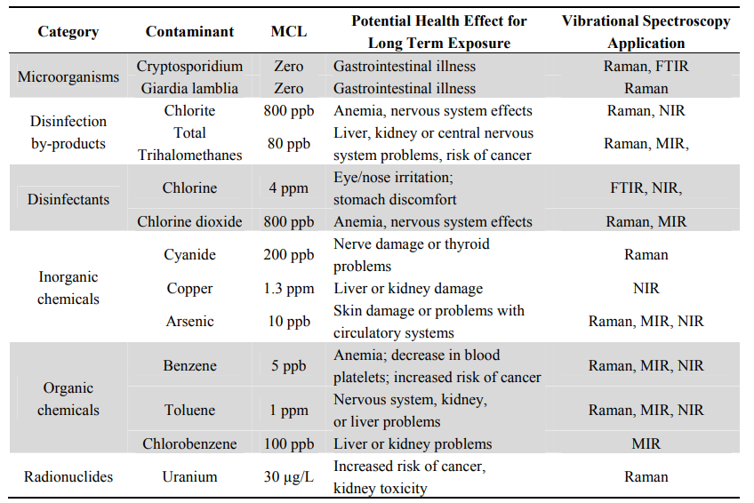
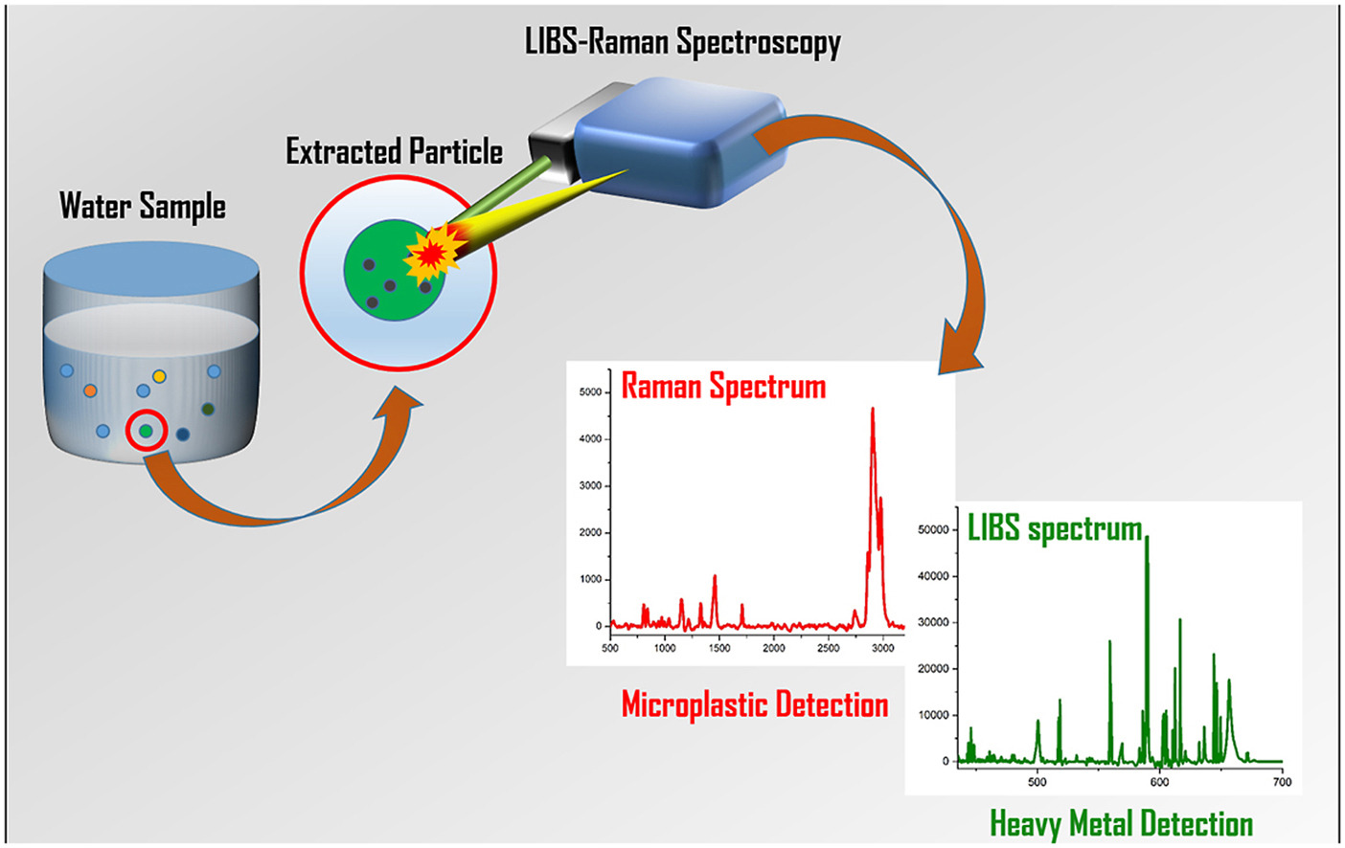
Portable Raman Spectroscopy for Water Quality Monitoring in Remote Indigenous Communities
The Solution
Unique molecular fingerprints for each contaminant
Portable, handheld system
No lab needed: results in minutes
Works ideally with water samples
Detects at parts-per-billion levels
The Problem
19 communities (WA): Nitrate >50 ppm
NT: Uranium 57 µg/L (3× limit)
SA: Hardness, fluoride, turbidity
>500 communities lack consistent testing
The Approach
Data Sovereignty: Communities own their data
Build Competency, not Dependency: Train Indigenous rangers
Genuine Benefit: Fix problems, don't just document
References:
[1] R. Fielden, “Real-time water quality monitoring for Homeland communities,” Australian Water Association, 2024.
[2] Z. Li, M. J. Deen, S. Kumar and P. R. Selvaganapathy, “Raman Spectroscopy for In-Line Water Quality Monitoring Instrumentation and Potential,” Sensors, vol. 14, no. 9, pp. 17275-17303, 2014.
[3] B. K. Balasooriya, J. Rajapakse and C. Gallage, “A review of drinking water quality issues in remote and indigenous communities in rich nations with special emphasis on Australia,” Science of the Total Environment, vol. 903, 2023.

Slide 5
Raman Spectroscopy for Water Quality Monitoring in Remote Indigenous Communities
The Problem
The Solution
The Ethics
Building Trust

Slide 6
Portable Raman Spectroscopy for Water Quality Monitoring in Remote Indigenous Communities
The Solution
Unique molecular fingerprints for each contaminant
Portable, handheld system
No lab needed: results in minutes
Works ideally with water samples
Detects at parts-per-billion levels
The Problem
19 communities (WA): Nitrate >50 ppm
NT: Uranium 57 µg/L (3× limit)
SA: Hardness, fluoride, turbidity
>500 communities lack consistent testing
The Approach
1. Data Sovereignty
Communities own their data
2. Build Competency, not Dependency
Train Indigenous rangers
3. Genuine Benefit
Fix problems, don't just document

